Slide 1

Hypothesis Testing

Slide 2
What is Hypothesis?
An idea or explanation of something that is based on a few known facts but that has not yet been proved to be true or correct.
-- Oxford Dictionary

Slide 3
What is Hypothesis?
Testing a known assumption that is generally accepted as the truth.
Testing a claim that is supposed to change the current facts.

Slide 4






Null Vs Alternate Hypothesis
H₀
H_{a}
There is no change from the stated facts.
The stated facts are incorrect
Chocolate bars weigh 100 gms or more
Chocolate bars weigh less than 100 gms
=
≤
≥
≠
<
>

Slide 5

Statistical Significance

Slide 6
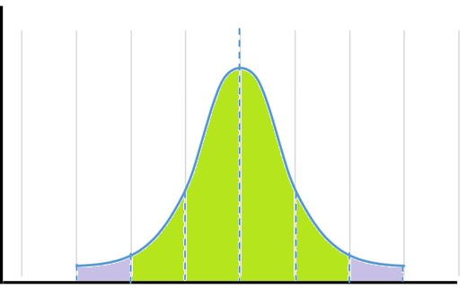

Statistical Significance
H₀
H_{a}
We expect this to happen.
We don’t expect this.
It happened.
Still it happened.
Nothing changes.
Null Hypothesis is true.
Status quo remains.
Null Hypothesis rejected.
Status quo or claim is rejected

Slide 7

Important terms – Statistical Significance
95% Probability
P → Observed or seen Probability of the sample
P < α
Rejection Region Probability of rejection region → α
Reject Null Hypothesis

Slide 8
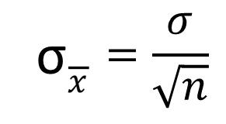
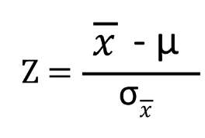
Hypothesis Testing
Current average waiting period for the customers who call the customer service helpline is 100 seconds with a standard deviation of 20 seconds. Certain changes were recently done to the IVR menu options as well as the overall customer service processes. After a week, the management picked-up a sample of 100 calls and found that the average waiting period was 95 seconds. Have the process implementations resulted in the waiting period reduction?
H₀
H_{a}
State Population parameters and Sample statistics
μ = 100; σ = 20; N = 100; X = 95;
Compute Sample Standard Deviation and Z-Value
: null hypothesis : There is no change in the waiting period.
: alternate hypothesis : The waiting period has reduced.
Significance Level; α = 0.05 or 5%
3. Compute ρ using Z-Score for the Z-value
ρ = 0.62%

Slide 9
Hypothesis Testing
Current average waiting period for the customers who call the customer service helpline is 100 seconds with a standard deviation of 20 seconds. Certain changes were recently done to the IVR menu options as well as the overall customer service processes. After a week, the management picked-up a sample of 100 calls and found that the average waiting period was 95 seconds. Have the process implementations resulted in the waiting period reduction?
H₀
H_{a}
ρ < α
Population parameters and Sample statistics
; σ = 20; N = 100; X = 95;
pute Sample Standard Deviation and Z-Value
1. State
he waiting period. _{μ = 100}
2. Com
d has reduced.
: null hypothesis : There is no change in t
: alternate hypothesis : The waiting perio
Reject Null
Significance Level; α = 0.05 or 5%
3. Compute ρ using Z-Score for the Z-value
ρ = 0.62%

Slide 10
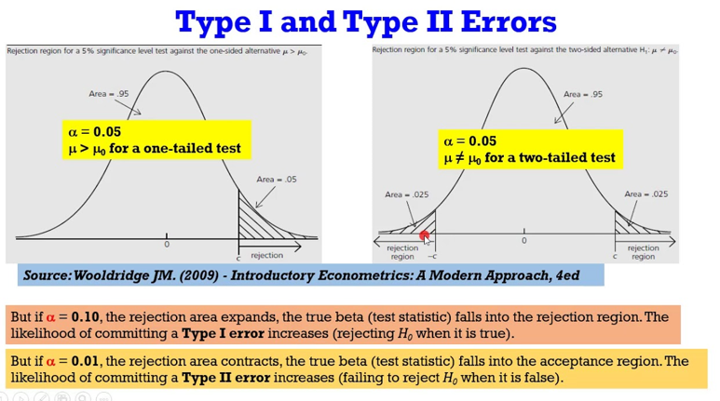

Slide 11
Large Sample Theory:
The sample size n is greater than 30 (n≥30) it is known as large sample. For large samples the sampling distributions of statistic are normal(Z test). A study of sampling distribution of statistic for large sample is known as large sample theory.
Small Sample Theory
If the sample size n ils less than 30 (n<30), it is known as small sample. For small samples the sampling distributions are t, F and χ2 distribution. A study of sampling distributions for small samples is known as small sample theory.

Slide 12
What is a Parametric Test?
In Statistics, the generalizations for creating records about the mean of the original population is given by the parametric test. This test is also a kind of hypothesis test. A t-test is performed and this depends on the t-test of students, which is regularly used in this value. This is known as a parametric test.
What is a Non-Parametric Test?
There is no requirement for any distribution of the population in the non-parametric test. Also, the non-parametric test is a type hypothesis test that is not dependent on any underlying hypothesis. In the non-parametric test, the test depends on the value of the median. This method of testing is also known as distribution-free testing. Test values are found based on the ordinal or the nominal level. The parametric test is usually performed when the independent variables are non-metric. This is known as a non-parametric test.

Slide 13
Measurement and Sampling Techniques

Slide 14
Measurement and Scaling Techniques
Measurement means assigning numbers or other symbols to characteristics of objects according to certain prespecified rules. – One-to-one correspondence between the numbers and the characteristics being measured. – The rules for assigning numbers should be standardized and applied uniformly. – Rules must not change over objects or time.
One-to-one correspondence between the numbers and the characteristics being measured.
The rules for assigning numbers should be standardized and applied uniformly.
Rules must not change over objects or time.
Scaling involves creating a continuum upon which measured objects are located.
Consider an attitude scale from 1 to 100. Each respondent is assigned a number from 1 to 100, with 1 = Extremely Unfavorable, and 100 = Extremely Favorable.
Measurement is the actual assignment of a number from 1 to 100 to each respondent.
Scaling is the process of placing the respondents on a continuum with respect to their attitude toward department stores.

Slide 15
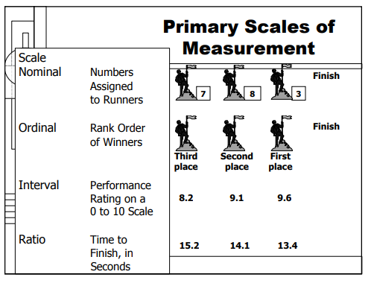

Slide 16
Nominal Scale:
The numbers serve only as labels or tags for identifying and classifying objects.
When used for identification, there is a strict one-to-one correspondence between the numbers and the objects.
The numbers do not reflect the amount of the characteristic possessed by the objects.
The only permissible operation on the numbers in a nominal scale is counting.
Only a limited number of statistics, all of which are based on frequency counts, are permissible, e.g., percentages, and mode.
Ordinal Scale:
A ranking scale in which numbers are assigned to objects to indicate the relative extent to which the objects possess some characteristic.
Can determine whether an object has more or less of a characteristic than some other object, but not how much more or less. Any series of numbers can be assigned that preserves the ordered relationships between the objects.
In addition to the counting operation allowable for nominal scale data, ordinal scales permit the use of statistics based on centiles, e.g., percentile, quartile, median

Slide 17
Interval Scale:
Numerically equal distances on the scale represent equal values in the characteristic being measured.
It permits comparison of the differences between objects.
The location of the zero point is not fixed. Both the zero point and the units of measurement are arbitrary.
Any positive linear transformation of the form y = a + bx will preserve the properties of the scale.
It is meaningful to take ratios of scale values.
Statistical techniques that may be used include all of those that can be applied to nominal and ordinal data, and in addition the arithmetic mean, standard deviation, and other statistics commonly used in marketing research.
Ration Scale:
Possesses all the properties of the nominal, ordinal, and interval scales.
It has an absolute zero point.
It is meaningful to compute ratios of scale values.
Only proportionate transformations of the form y = bx, where b is a positive constant, are allowed.
All statistical techniques can be applied to ratio data.

Slide 18

Thank You!

